Slide 1
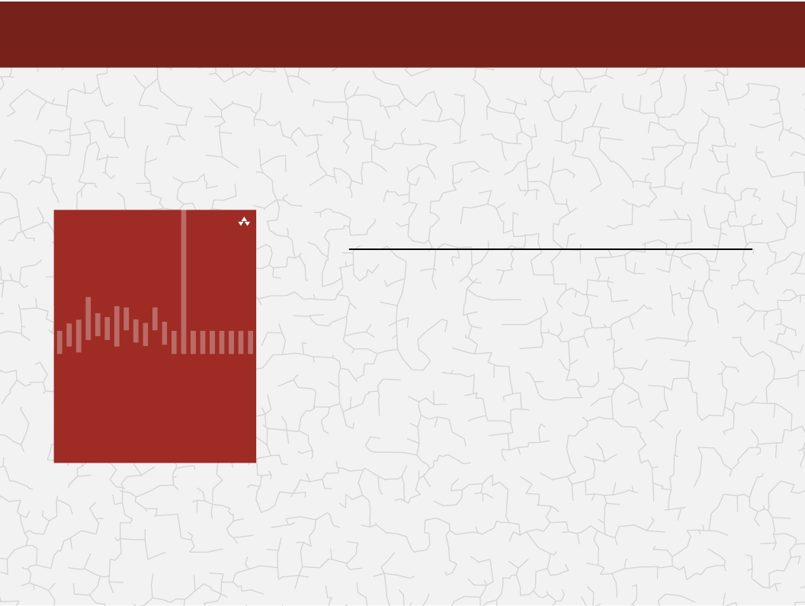
Categories of algorithms
Sorting algorithms
Search algorithms
Graph algorithms
Path-finding in AI algorithms
Network Flow algorithms
Computational Geometry
Algorithms: Theory, Design and Implementation
Algorithms
F O U R T H E D I T I O N
@Sudharshan Welihinda - 2021

Slide 2
Algorithms
Algorithms
GRAPHS
Definitions
Graph representation
Depth-first, Breadth-first search algorithms
Single source shortest path
All pairs shortest path (Dijkstra’s algorithm)
Minimum spanning tree algorithms
(kruskal and Prim algorithms)
F O U R T H E D I T I O N
@Sudharshan Welihinda - 2021

Slide 3
Graph Definitions
@Sudharshan Welihinda - 2021

Slide 4
Introduction to Graphs
Graphs are widely-used structure in computer science and different computer applications. We don't say data structure here and see the difference. Graphs mean to store and analyze metadata, the connections, which present in data.
For instance, consider cities in the country. Road network, which connects them, can be represented as a graph and then analyzed. We can examine, if one city can be reached from another city or find the shortest route between two cities etc.
@Sudharshan Welihinda - 2021

Slide 5
Introduction to Graphs
Graphs are cool and vital ways of representing information and relationships in the world around us. We can use graphs to do amazing stuff with computers, and graph algorithms offer a lot of tools to understand complex networks and relationships.
At its most basic, a graph is a group of dots connected by lines.
We use graphs to model relationships in the world. For example:
Google Maps uses a series of dots and lines to model the road network and give you directions to your final destination
Facebook friend networks are a graph where each person is a dot, and the friendships between people are lines
The Internet is a giant graph, where web pages are dots and the links between pages are lines
@Sudharshan Welihinda - 2021

Slide 6
Introduction to Graphs
We can model objects in physical space, relationships between people, and document structures all using graphs, simple dots and lines!
Once we have the relationships modeled, we can:
Find the shortest path between two points
Identify groups of relationships
Store data and create links between it in almost any context (think linked lists and trees)
Graphs are everywhere, all around you! But chances are you don’t really understand them.
@Sudharshan Welihinda - 2021

Slide 7
Definitions
Graph is a data structure that consists of following two components:
1. A finite set of vertices also called as nodes.
2. A finite set of ordered pair of the form (u, v) called as edge.
G = (V,E)
V is the vertex set.
Vertices are also called nodes and points.
E is the edge set.
Each edge connects two different vertices.
Edges are also called arcs and lines.
Directed edge has an orientation (u,v).
u
  v
@Sudharshan Welihinda - 2021

Slide 8
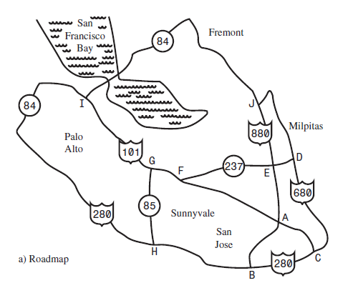
A Road Map of Silicon Valley
@Sudharshan Welihinda - 2021

Slide 9
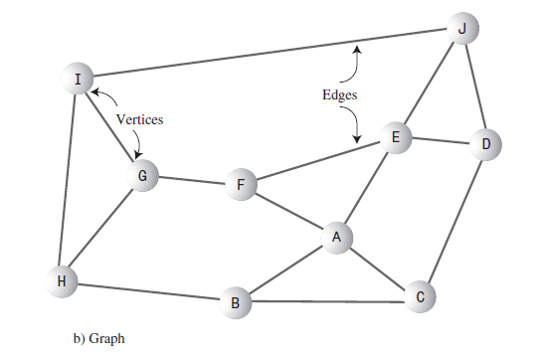
...and its corresponding Graph
@Sudharshan Welihinda - 2021

Slide 10
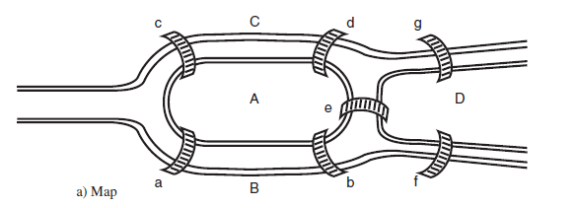
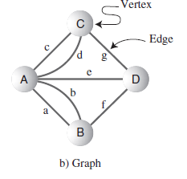
Historical Note: Euler and the Bridges of Königsberg
First real-world graph application
@Sudharshan Welihinda - 2021

Slide 11
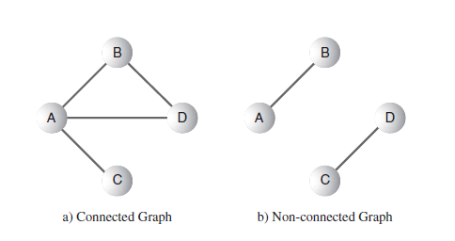
Connected vs. Non-connected Graphs
@Sudharshan Welihinda - 2021

Slide 12
Directed vs. Undirected Graphs
Undirected edge has no orientation (u,v).
u
  v
Undirected graph => no oriented edge.
Directed graph => every edge has an orientation.
@Sudharshan Welihinda - 2021

Slide 13
Undirected Graph
2
3
8
1
10
4
5
9
11
6
7
@Sudharshan Welihinda - 2021

Slide 14
Directed Graph (Digraph)
2
3
8
1
10
4
5
9
11
6
7
@Sudharshan Welihinda - 2021

Slide 15
Applications—Communication Network
2
3
8
1
10
4
5
9
11
6
7
Vertex = city, edge = communication link.
@Sudharshan Welihinda - 2021
Notes:
Internet connection. Vertices are computers. Send email from 1 to 7.

Slide 16
Driving Distance/Time Map
A weighted graph
2
4
3
8
8
1
6
10
2
4
5
4
4
3
5
9
11
5
6
6
7
7
Vertex = city, edge weight = driving distance/time.
@Sudharshan Welihinda - 2021

Slide 17
Street Map
A hybrid (un)directed graph
2
3
8
1
10
4
5
9
11
6
7
Some streets are one way.
@Sudharshan Welihinda - 2021

Slide 18
Complete Undirected Graph
Has all possible edges.
n = 4
n = 1
n = 2
n = 3
@Sudharshan Welihinda - 2021

Slide 19
Number of Edges—Undirected Graph
Each edge is of the form (u,v), u != v.
Number of such pairs in an n vertex graph is n(n-1).
Since edge (u,v) is the same as edge (v,u), the number of edges in a complete undirected graph is n(n-1)/2.
Number of edges in an undirected graph is ≤ n(n-1)/2.
@Sudharshan Welihinda - 2021

Slide 20
Number of Edges—Directed Graph
Each edge is of the form (u,v), u != v.
Number of such pairs in an n vertex graph is n(n-1).
Since edge (u,v) is not the same as edge (v,u), the number of edges in a complete directed graph is n(n-1).
Number of edges in a directed graph is ≤ n(n-1).
@Sudharshan Welihinda - 2021

Slide 21
Vertex Degree
2
3
8
1
10
4
5
9
11
6
7
Number of edges incident to vertex.
degree(2) = 2, degree(5) = 3, degree(3) = 1
@Sudharshan Welihinda - 2021

Slide 22
Sum of Vertex Degrees
8
10
9
11
Sum of degrees = 2e (e is number of edges)
@Sudharshan Welihinda - 2021

Slide 23
In-Degree of a Vertex
2
3
8
1
10
4
5
9
11
6
7
In-Degree is number of incoming edges
In-Degree(2) = 1, In-Degree(8) = 0
@Sudharshan Welihinda - 2021

Slide 24
Out-Degree of a Vertex
2
3
8
1
10
4
5
9
11
6
7
Out-Degree is number of outbound edges
Out-Degree(2) = 1, Out-Degree(8) = 2
@Sudharshan Welihinda - 2021

Slide 25
Sum of In- and Out-Degrees
each edge contributes 1 to the in-degree of some vertex and 1 to the out-degree of some other vertex
sum of in-degrees = sum of out-degrees = e,
  where e is the number of edges in the digraph
@Sudharshan Welihinda - 2021

Slide 26
Some important graphs:
A planar graph - vertices and edges can be drawn in a plane such that no two of the edges intersect
A cycle graph - length n ≥ 3, vertices can be named v₁, ..., v_{n} so that the edges are v_{i−1}v_{i} for each i = 2,...,n in addition to v_{n}v₁
A bipartite graph - the vertex set can be partitioned into two sets, W and X, so that no two vertices in W are adjacent and no two vertices in X are adjacent
A tree graph
@Sudharshan Welihinda - 2021

Slide 27


Graph Representations
@Sudharshan Welihinda - 2021

Slide 28
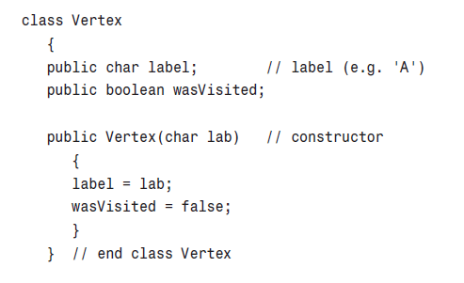
How to represent a Vertex in Java
@Sudharshan Welihinda - 2021

Slide 29
Fine with Vertices, but how about Edge Representation?
Unlike trees, free-form since any vertex can be connected with any number of other vertices…
Therefore,
Adjacency Matrix
Adjacency Lists
Incidence Matrix
@Sudharshan Welihinda - 2021

Slide 30
Adjacency Matrix
0/1 n x n matrix, where n = # of vertices
A(i,j) = 1 iff (i,j) is an edge
1
2
3
4
5
2
1
0
1
0
1
0
3
2
1
0
0
0
1
1
3
0
0
0
0
1
4
4
1
0
0
0
1
5
5
0
1
1
1
0
@Sudharshan Welihinda - 2021

Slide 31
Adjacency Matrix Properties
1
2
3
4
5
2
1
0
1
0
1
0
3
2
1
0
0
0
1
1
3
0
0
0
0
1
4
4
1
0
0
0
1
5
5
0
1
1
1
0
Diagonal entries are zero.
Adjacency matrix of an undirected graph is symmetric.
  A(i,j) = A(j,i) for all i and j.
@Sudharshan Welihinda - 2021

Slide 32
Adjacency Matrix (Digraph)
1
2
3
4
5
2
1
0
0
0
1
0
3
2
1
0
0
0
1
1
3
0
0
0
0
0
4
4
0
0
0
0
1
5
5
0
1
1
0
0
Diagonal entries are zero.
Adjacent matrix of a digraph need not be symmetric.
@Sudharshan Welihinda - 2021

Slide 33
Representation of Weighted Graph
70
A
B
C
D
A
B
A
B
70
10
30
10
C
30
D
D
20
C
20
@Sudharshan Welihinda - 2021

Slide 34
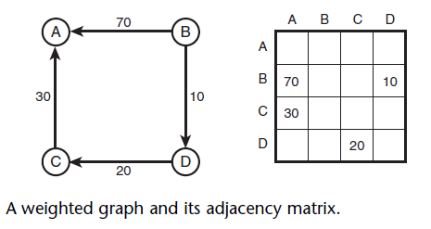
Representation of Weighted Graph
@Sudharshan Welihinda - 2021

Slide 35
Adjacency Matrix
n² bits of space
For an undirected graph, may store only lower or upper triangle (exclude diagonal).
  (n-1)n/2 bits
O(n) time to find vertex degree and/or vertices adjacent to a given vertex.
@Sudharshan Welihinda - 2021

Slide 36
Linked Adjacency Lists
Each adjacency list is a chain.
2
aList[1]
2
4
3
[2]
1
5
1
[3]
5
[4]
5
1
4
aList[5]
2
4
3
5
Array Length = n
# of chain nodes = 2e (undirected graph)
# of chain nodes = e (digraph)
@Sudharshan Welihinda - 2021
Notes:
Array length n simply means we need an array with n spots. A direct implementation using a Java array would need n+1 spots, because spot 0 would not be utilized. However, by using spot 0 for vertex 1, spot 1 for vertex 2, and so on, we could get by with a Java array whose length is actually n.

Slide 37
Incidence Matrix for a Directed Graph
An Incidence Matrix for a directed graph is represented using a matrix of size: number of vertices by number of edges, that is card(V ) × card(E).
Incidence Matrix, rows represent vertices and columns represent the edges. Each matrix position IM[v][e] is assigned either 0, 1, -1 or 2 and represents:
I IM[v][e] = 0 – vertex v is not the source or destination vertices for
edge e , i.e. e = (vi, vj), v =6 vi, v 6= vj.
I IM[v][e] = 1 – vertex v is the source vertices for edge e , i.e.
e = (vi, vj), v = vi, v =6 vj.
I IM[v][e] = -1 – vertex v is the destination vertices for edge e , i.e.
e = (vi, vj), v =6 vi, v = vj.
I IM[v][e] = 2 – vertex v is the source and destination vertices for
edge e , which is a self-loop vertex, e = (vi, vj), v = vi, v = vj.
Note: for an undirected graph it is only necessary to use 0 and 1, since there is no direction associated with an edge.
<number>/49

Slide 38

Incidence Matrix for a Directed Graph:
Consider the edges for G9 :
e1 = (A, B), e2 = (A, C), e3 = (A, D),
e5 = (C, D), e6 = (E, D), e7 = (E, E),
Then the incidence Matrix for G9 is:
e4 = (B, E),
e8 = (D, A)
2
A B
1
1
2
4
E
1
C
D
5
G9
IM (G9)
e1 |  | e2 | e3 | e4 | e5 | e6 | e7 | e8
A | 1 | 1 | 1 | 0 | 0 | 0 | 0 | −1
B | −1 | 0 | 0 | 1 | 0 | 0 | 0 | 0
C | 0 | −1 | 0 | 0 | 1 | 0 | 0 | 0
D | 0 | 0 | −1 | 0 | −1 | −1 | 0 | 1
E | 0 | 0 | 0 | −1 | 0 | 1 | 2 | 0
5SENG003W Lecture 7: Graphs I
<number>/49

Slide 39
Question 1
Let us assume you are given a graph with vertices {A,B,C,D} and the relationships and the edges {A leads to B}, {B leads to A,C,D} , {C leads to B}, {D leads to B}
Provide the corresponding adjacency matrix in terms of {0,1} elements, which reflects the graph above, and justify whether the feature of symmetry for the matrix hold or not.
Subsequently, provide an alternative representation of the graph based to be implemented with the help of an array.
@Sudharshan Welihinda - 2021

Slide 40
Question 2
Let us assume you are given four friends, {Soniya, Anna, Matilda, Dora}, and the relationships {Soniya likes Anna}, {Anna likes Soniya, Matilda, Dora}, {Matilda likes Anna}, {Dora likes Anna}. Suggest a data structure and its two alternative implementations capable of representing the knowledge about the four friends above.
Question 3
The following sets of vertices V and edges E represent a directed graph: V = { 1, 2, 3, 4, 5, 6, 7 } E = { (1, 2), (2, 3), (2, 4), (3, 5), (4, 7), (5, 4), (5, 6), (6, 7), (7, 1) }
Draw the graph represented by V and E above and give its associated adjacency list and adjacency matrix. In addition, state, with justification, which of these two methods would be the “better” way to represent the graph. [10 marks]
@Sudharshan Welihinda - 2021

Slide 41
Question 1 [12 Marks]
Adjacency Matrix
B
 | A | B | C | D
A | 0 | 1 | 0 | 0
B | 1 | 0 | 1 | 0
C | 0 | 1 | 0 | 0
D | 0 | 1 | 0 | 0
A
D
C
Each correct row will get a 1. mark. i.e. 1 * 4 rows = [4 Marks]
The matrix is symmetrical.
Justification:
Since the given edges are not directed. A careful consideration of all given relationships proves that they all lead to each other, though the meaning of “leads to” relationship is directed.
[3 Marks]
Adjacency List
Array
A
B
C
D
B
A
C
B
B
Each correct array node list entry will get 1 mark. i.e 1 * 4 (node) = 4 marks + 1 mark for mentioning the alternative method as “Adjacency List” [5 Marks]
Note : The marking scheme can get changed depending on the question. This is just to give an idea to you based on the past years marking schemes.

Slide 42
Array Adjacency Lists
Adjacency list for vertex i is a linear list of vertices adjacent from vertex i.
An array of n adjacency lists.
The graph with n=5 nodes has the following edges:
2
3
1 2 3 4 5 | (1,2), (1,4) (2,1), (2,5) (3,5) (4,1), (4,5) (5,2), (5,3)
1
4
5
We can store the edges in two arrays edge_u[] and edge_v[], where (edge_u[i], edge_v[i]) represents an edge between two nodes. The arrays have the length M, where M is the number of edges. They look like this:
1 2 | edge_u = [0, 0, 0, 1, 1, 1, 1, 2, 2, 3, 3, 3, 3, 4, 4, 4] edge_v = [1, 3, 4, 0, 2, 3, 4, 1, 3, 0, 1, 2, 4, 0, 1, 3]
@Sudharshan Welihinda - 2021

Slide 43
Array Adjacency Lists
Each adjacency list is an array list.
2
aList[1]
2
4
3
[2]
1
5
1
[3]
5
[4]
5
1
4
aList[5]
2
4
3
5
Array Length = n
# of list elements = 2e (undirected graph)
# of list elements = e (digraph)
@Sudharshan Welihinda - 2021

Slide 44
Some Abstract Methods of Graph
// ADT methods
public abstract int vertices();
public abstract int edges();
public abstract boolean existsEdge(int i, int j);
public abstract void putEdge(Object theEdge);
public abstract void removeEdge(int i, int j);
public abstract int degree(int i);
public abstract int inDegree(int i);
public abstract int outDegree(int i);
@Sudharshan Welihinda - 2021

Slide 45
Can you represent this WEIGHTED graph with an adjacency list?
@Sudharshan Welihinda - 2021

Slide 46
How do I walk through the graph? SEARCH
@Sudharshan Welihinda - 2021

Slide 47
Graph Search Methods
Many graph problems solved using a search method.
  Path from one vertex to another.
  Is the graph connected?
  Find a spanning tree.
  Etc.
Commonly used search methods:
  Breadth-first search.
  Depth-first search.
@Sudharshan Welihinda - 2021

Slide 48
Breadth-First Search (BFS)
The breadth-first traversal, or search, algorithm visits all vertices adjacent to the starting vertex, then visits all vertices adjacent to those vertices , and so on.
Since all adjacent vertices are visited before probing further, the search is broad rather than deep, hence the term "breadth-first".
The following gives a breadth-first traversal, or search, of a graph stored in matrix 'm' (starting from vertex 1):
  BFSearch:
  FOR v<--1 TO maxVertex DO
  visited[v] = false;
  ENDFOR
  FOR v<--1 TO maxVertex DO
  IF (!visited[v]) THEN
  bfs(v);
  ENDIF
  ENDFOR
@Sudharshan Welihinda - 2021

Slide 49
  bfs(vertex v):
  Q <-- empty_queue; /* FIFO queue structure */
  visited[v] = true;
  add v to rear of Q;
  WHILE Q is not empty DO
  u <-- remove front item in Q;
  FOR w<--1 TO maxVertex DO
  IF ((m[u][w] == true) AND (!visited[w])) THEN
  visited[w] = true;
  add w to rear of Q;
  ENDIF
  ENDFOR
  ENDWHILE
Note that this algorithm is not recursive. It employs a queue data structure to store the neighbours of a given vertex.
@Sudharshan Welihinda - 2021

Slide 50
Breadth-First Search
Visit start vertex and put into a FIFO queue.
Repeatedly remove a vertex from the queue, visit its unvisited adjacent vertices, put newly visited vertices into the queue.
@Sudharshan Welihinda - 2021

Slide 51
Pseudocode of BFS
put starting node in the queue
while queue is not empty
  get first node from the queue, name it v
  (process v)
  for each edge e going from v to other nodes
    put the other end of edge e at the end of the queue
@Sudharshan Welihinda - 2021

Slide 52
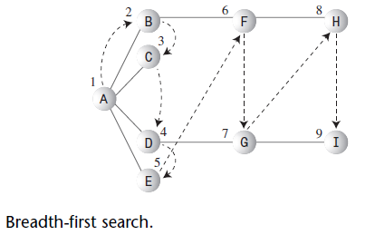
Breadth-first Search with a Queue
Event Queue(Front & Rear)
Visit A
Visit B B
Visit C B C
Visit D B C D
Visit E B C D E
Remove B C D E
Visit F C D E F
Remove C D E F
Remove D E F
Visit G E F G
Remove E F G
Remove F G
Visit H G H
Remove G H
Visit I H I
Remove H I
Remove I
@Sudharshan Welihinda - 2021

Slide 53
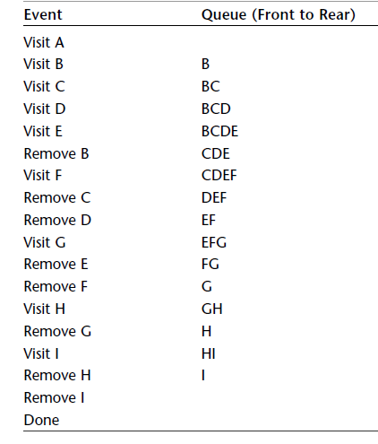
Breadth-first Search with a Queue
@Sudharshan Welihinda - 2021

Slide 54
Breadth-First Search Example
2
3
8
1
4
5
9
10
6
7
11
Start search at vertex 1.
@Sudharshan Welihinda - 2021

Slide 55
Breadth-First Search Example
2
FIFO Queue
1
3
8
1
1
4
5
9
10
6
7
11
Visit/mark/label start vertex and put in a FIFO queue.
@Sudharshan Welihinda - 2021

Slide 56
Breadth-First Search Example
2
FIFO Queue
1
3
8
1
1
4
5
9
10
6
7
11
Remove 1 from Q; visit adjacent unvisited vertices; put in Q.
@Sudharshan Welihinda - 2021

Slide 57
Breadth-First Search Example
2
FIFO Queue
2
3
2
4
8
1
1
4
4
5
9
10
6
7
11
Remove 1 from Q; visit adjacent unvisited vertices; put in Q.
@Sudharshan Welihinda - 2021

Slide 58
Breadth-First Search Example
2
FIFO Queue
2
3
2
4
8
1
1
4
4
5
9
10
6
7
11
Remove 2 from Q; visit adjacent unvisited vertices; put in Q.
@Sudharshan Welihinda - 2021

Slide 59
Breadth-First Search Example
2
FIFO Queue
2
3
3
4
5
3
6
8
1
1
4
4
5
5
9
10
6
6
7
11
Remove 2 from Q; visit adjacent unvisited vertices; put in Q.
@Sudharshan Welihinda - 2021

Slide 60
Breadth-First Search Example
2
FIFO Queue
2
3
3
4
5
3
6
8
1
1
4
4
5
5
9
10
6
6
7
11
Remove 4 from Q; visit adjacent unvisited vertices; put in Q.
@Sudharshan Welihinda - 2021

Slide 61
Breadth-First Search Example
2
FIFO Queue
2
3
3
5
3
6
8
1
1
4
4
5
5
9
10
6
6
7
11
Remove 4 from Q; visit adjacent unvisited vertices; put in Q.
@Sudharshan Welihinda - 2021

Slide 62
Breadth-First Search Example
2
FIFO Queue
2
3
3
5
3
6
8
1
1
4
4
5
5
9
10
6
6
7
11
Remove 5 from Q; visit adjacent unvisited vertices; put in Q.
@Sudharshan Welihinda - 2021

Slide 63
Breadth-First Search Example
2
FIFO Queue
2
3
3
3
6
9
7
8
1
1
4
4
5
5
9
9
10
6
6
7
7
11
Remove 5 from Q; visit adjacent unvisited vertices; put in Q.
@Sudharshan Welihinda - 2021

Slide 64
Breadth-First Search Example
2
FIFO Queue
2
3
3
3
6
9
7
8
1
1
4
4
5
5
9
9
10
6
6
7
7
11
Remove 3 from Q; visit adjacent unvisited vertices; put in Q.
@Sudharshan Welihinda - 2021

Slide 65
Breadth-First Search Example
2
FIFO Queue
2
3
3
6
9
7
8
1
1
4
4
5
5
9
9
10
6
6
7
7
11
Remove 3 from Q; visit adjacent unvisited vertices; put in Q.
@Sudharshan Welihinda - 2021

Slide 66
Breadth-First Search Example
2
FIFO Queue
2
3
3
6
9
7
8
1
1
4
4
5
5
9
9
10
6
6
7
7
11
Remove 6 from Q; visit adjacent unvisited vertices; put in Q.
@Sudharshan Welihinda - 2021

Slide 67
Breadth-First Search Example
2
FIFO Queue
2
3
3
9
7
8
1
1
4
4
5
5
9
9
10
6
6
7
7
11
Remove 6 from Q; visit adjacent unvisited vertices; put in Q.
@Sudharshan Welihinda - 2021

Slide 68
Breadth-First Search Example
2
FIFO Queue
2
3
3
9
7
8
1
1
4
4
5
5
9
9
10
6
6
7
7
11
Remove 9 from Q; visit adjacent unvisited vertices; put in Q.
@Sudharshan Welihinda - 2021

Slide 69
Breadth-First Search Example
2
FIFO Queue
2
3
3
7
8
8
8
1
1
4
4
5
5
9
9
10
6
6
7
7
11
Remove 9 from Q; visit adjacent unvisited vertices; put in Q.
@Sudharshan Welihinda - 2021

Slide 70
Breadth-First Search Example
2
FIFO Queue
2
3
3
7
8
8
8
1
1
4
4
5
5
9
9
10
6
6
7
7
11
Remove 7 from Q; visit adjacent unvisited vertices; put in Q.
@Sudharshan Welihinda - 2021

Slide 71
Breadth-First Search Example
2
FIFO Queue
2
3
3
8
8
8
1
1
4
4
5
5
9
9
10
6
6
7
7
11
Remove 7 from Q; visit adjacent unvisited vertices; put in Q.
@Sudharshan Welihinda - 2021

Slide 72
Breadth-First Search Example
2
FIFO Queue
2
3
3
8
8
8
1
1
4
4
5
5
9
9
10
6
6
7
7
11
Remove 8 from Q; visit adjacent unvisited vertices; put in Q.
@Sudharshan Welihinda - 2021

Slide 73
Breadth-First Search Example
2
FIFO Queue
2
3
3
8
8
1
1
4
4
5
5
9
9
10
6
6
7
7
11
Queue is empty. Search terminates.
@Sudharshan Welihinda - 2021

Slide 74
Breadth-First Search Property
All vertices reachable from the start vertex (including the start vertex) are visited.
@Sudharshan Welihinda - 2021

Slide 75
Depth-First Search (DFS)
The depth-first traversal, or search, finds all graph vertices reachable from a particular starting vertex in a way that explores a given path from the starting vertex before starting another path.
The search strategy is to probe deeper and deeper along a path, before backtracking hence the name "depth-first".
Goes on until it visits a node with no successors or a node with all successors already visited.
A depth-first search algorithm requires that each vertex is visited (and processed) exactly once.
Since graphs can have cycles, we need a way of keeping track of the vertices that have already been visited.
In the algorithm that follows this is achieved via the array 'visited' which can be declared as, bool visited[maxVertex], and maxVertex represents the maximum number of vertices in a graph.
@Sudharshan Welihinda - 2021

Slide 76
DFS - algorithm
The algorithm first marks vertex 1 as having been visited.
Then if there is a vertex adjacent to vertex 1 (i.e. a destination vertex for which vertex 1 is a source vertex) that has not yet been visited, this vertex is chosen as the next starting point and the depth-first search function (dfs) is called recursively, etc.
The recursion stops only when exploration of the graph is blocked and can go no further.
At this point the recursion "unwinds" so alternative possibilities at higher levels can be explored.
The depth-first search algorithm is normally implemented using a stack.
@Sudharshan Welihinda - 2021

Slide 77
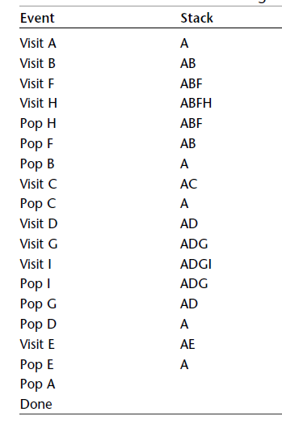
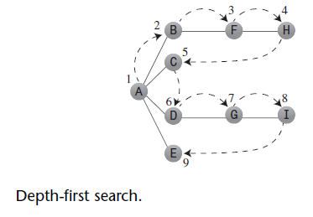
Depth-first Search with a Stack
@Sudharshan Welihinda - 2021

Slide 78
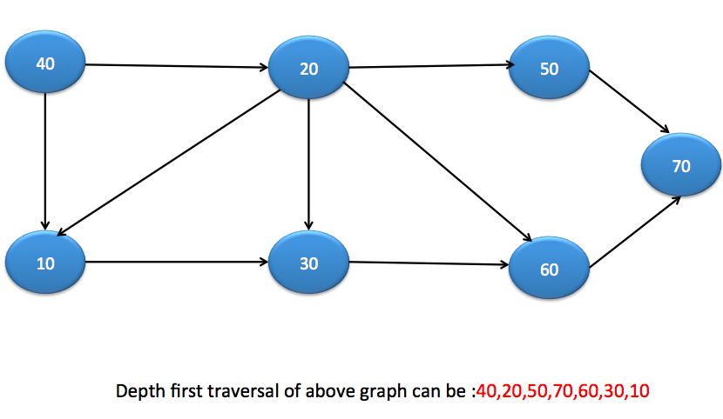
@Sudharshan Welihinda - 2021

Slide 79
Pathfinding: improving on DFS
► Pathfinding is often required to find shortest paths
► Depth-first search does not do this.
► Breadth-first search works for unweighted graphs
► Next time, we will look at two more advanced algorithms:
► Dijkstra’s algorithm
► The A* algorithm
► The setting will be weighted graphs
► An edge’s weight represents the length (or cost or duration) associated with it
► An unweighted graph is just a special case where all weights are 1.

Slide 80
Graph Operations
@Sudharshan Welihinda - 2021

Slide 81
Sample Graph Problems
Path problems.
Connectedness problems.
Spanning tree problems.
@Sudharshan Welihinda - 2021

Slide 82
Path Finding
Path between 1 and 8.
2
4
3
8
8
1
6
10
2
4
5
4
4
3
5
9
11
5
6
6
7
7
Path length is 20.
@Sudharshan Welihinda - 2021
Notes:
Vertices represent cities and edges represent highways. Edge weights are distances or driving times. Depending on the context, path length may either be the number of edges on the path or the sum of the weights of the edges on the path.

Slide 83
Another Path Between 1 and 8
2
4
3
8
8
1
6
10
2
4
5
4
4
3
5
9
11
5
6
6
7
7
Path length is 28.
@Sudharshan Welihinda - 2021
Notes:
Since a graph may have more than one path between two vertices, we may be interested in finding a path with a particular property. For example, find a path with minimum length

Slide 84
Example of No-Path
2
3
8
1
10
4
5
9
11
6
7
No path between 2 and 9.
@Sudharshan Welihinda - 2021

Slide 85
Connected Graph
Undirected graph.
There is a path between every pair of vertices.
@Sudharshan Welihinda - 2021

Slide 86
Example of Not-Connected
2
3
8
1
10
4
5
9
11
6
7
@Sudharshan Welihinda - 2021

Slide 87
Connected Graph Example
2
3
8
1
10
4
5
9
11
6
7
@Sudharshan Welihinda - 2021
Notes:
Determine whether an undirected graph is connected.

Slide 88
Connected Components
2
3
8
1
10
4
5
9
11
6
7
@Sudharshan Welihinda - 2021

Slide 89
Connected Component
A maximal sub-graph that is connected
A connected graph has exactly 1 component.
@Sudharshan Welihinda - 2021

Slide 90
Not A Component
2
3
8
1
10
4
5
9
11
6
7
@Sudharshan Welihinda - 2021
Notes:
Determine connected components of an undirected graph

Slide 91
Communication Network
2
3
8
1
10
4
5
9
11
6
7
Each edge is a link that can be constructed (i.e., a feasible link).
@Sudharshan Welihinda - 2021

Slide 92
Communication Network Problems
Is the network connected?
  Can we communicate between every pair of cities?
Find the components.
Want to construct smallest number of feasible links so that resulting network is connected.
@Sudharshan Welihinda - 2021

Slide 93
Cycles And Connectedness
2
3
8
1
10
4
5
9
11
6
7
Removal of an edge that is on a cycle does not affect connectedness.
@Sudharshan Welihinda - 2021

Slide 94
Cycles And Connectedness
2
3
8
1
10
4
5
9
11
6
7
Connected subgraph with all vertices and minimum number of edges has no cycles.
@Sudharshan Welihinda - 2021

Slide 95

Tree
Connected graph that has no cycles.
n vertex connected graph with n-1 edges.
@Sudharshan Welihinda - 2021
Notes:
In graph terminology, the term rooted tree is used to denote what we were earlier calling a tree.

Slide 96
Spanning Tree
Subgraph that includes all vertices of the original graph.
Subgraph is a tree.
  If original graph has n vertices, the spanning tree has n vertices and n-1 edges.
@Sudharshan Welihinda - 2021

Slide 97
Minimum Cost Spanning Tree
2
4
3
8
8
1
6
10
2
4
5
4
4
3
5
9
8
11
5
6
2
6
7
7
Tree cost is sum of edge weights/costs.
@Sudharshan Welihinda - 2021

Slide 98
A Spanning Tree
2
4
3
8
8
1
6
10
2
4
5
4
4
3
5
9
8
11
5
6
2
6
7
7
Spanning tree cost = 51.
@Sudharshan Welihinda - 2021

Slide 99
Minimum Cost Spanning Tree
2
4
3
8
8
1
6
10
2
4
5
4
4
3
5
9
8
11
5
6
2
6
7
7
Spanning tree cost = 41.
@Sudharshan Welihinda - 2021
Notes:
In the communication networks area, we are interested in finding minimum cost spanning trees.

Slide 100
A Wireless Broadcast Tree
2
4
3
8
8
1
6
10
2
4
5
4
4
3
5
9
8
11
5
6
2
6
7
7
Source = 1, weights = needed power.
Cost = 4 + 8 + 5 + 6 + 7 + 8 + 3 = 41 instead of 51.
@Sudharshan Welihinda - 2021
Notes:
Edge cost is power needed to reach a node. If vertex 1 broadcasts with power 2, only vertex 4 is reached. If it broadcasts with power 4, both 2 and 4 are reached. Min-broadcast rooted spanning tree is NP-hard. Cost of tree of previous slide becomes 26.

Slide 101
WEIGHTED GRAPHS AND MORE
NEXT:
@Sudharshan Welihinda - 2021

